Slide 1

I2I Industry Workstream Presentation
Friday 23rd June
Hotel Kempinski, Geneva

Slide 2
Presentation Objectives
  Recap on the progress and key achievements of the workstream over the last 12 months
  Present the workstream’s view of WHO’s new product evaluation system
  Outline the future priorities of the workstream

Slide 3

















Industry Workstream: 17 Member Organisations

Slide 4
Industry Workstream Participants
    Andy Butenhoff, DCT (Joint Lead, 2017)
    Andy Bywater, Syngenta
    Ato deGraft-Johnson, SC Johnson
    Atsuko Hirooka, Sumitomo Chemical
    Dan Strickman, BMGF
    Dan Usry, SC Johnson
    Egon Weinmueller, BASF
    Francis Baud, Clariant
    Frederic Baur, Bayer
    Frederic Schmitt, Bayer
    Hans Mattar, AgroCare
    Helen Pates Jamet, Vestergaard
    Hiroaki Matsuoka, Mitsui Chemicals Agro
    Hiromi Yamamoto, Mitsui Chemicals Agro
    John Invest, Sumitomo Chemical
    John Lucas, Sumitomo Chemical
    Karen Larson, Clarke
    Klaus Roeder, SC Johnson
    Kunizo Mori, Mitsui Chemicals Agro
    Maude Meier, SC Johnson
    Nick Brown, A-Z Textile Mills
    Nick Hamon, IVCC
    Rafael Del Castillo, Mainpol
    Ray McAllister, Croplife America
    Rod Flinn, DCT
    Rune Bosselmann, Tana Netting
    Sarah Rees, IVCC (Joint Lead, 2017)
    Ted Bonertz, BASF
    Torben Holm Larsen, Real Relief
    Yuliana Ambriz, Clarke
30 conference call participants

Slide 5
Industry Workstream Objectives
From the Terms of Reference:
“The purpose of the Industry Workstream is to consolidate industry input on key topics across evaluation, procurement and registration in order to increase industry partnership, prioritization and investment in support of improved vector control.”

Slide 6
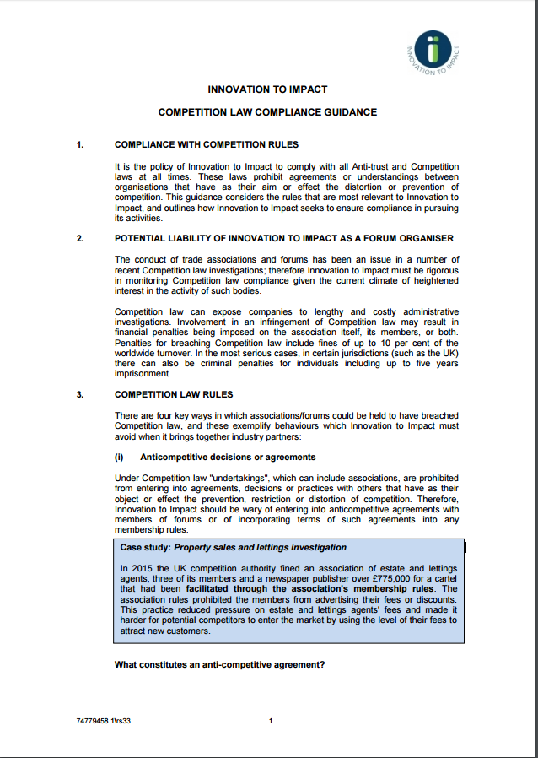
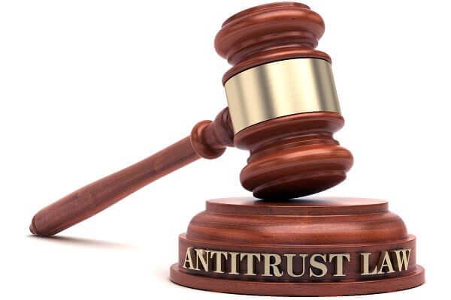
Industry Workstream Outputs
Anti-competition Policy adopted due to I2I’s potential liability as a forum organiser
Legal guidance document drawn up for I2I leadership team covering:
  Competition law rules
    Anti-competitive decisions or agreements
    Facilitating agreements between competitors
    Information exchange
    Membership criteria

Slide 7
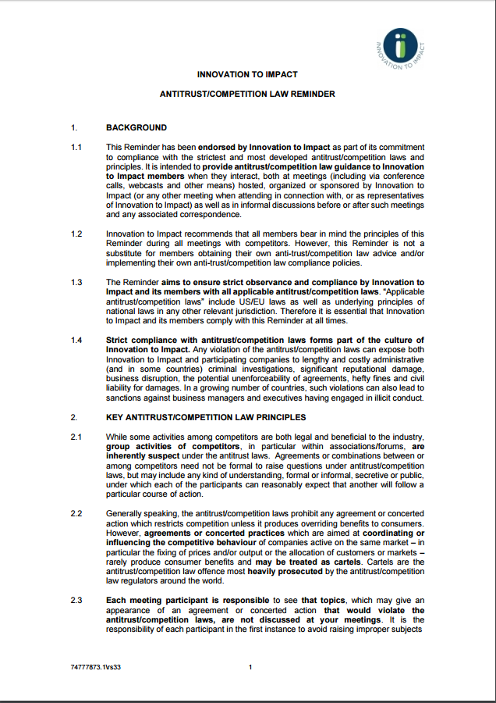
Industry Workstream Outputs
Anti-competition law reminder drawn up for workstream members covering key anti-trust/competition law principles

Slide 8


Industry Workstream Outputs
The CropLife International vector control group disbanded in 2016, coinciding with the forming of the I2I industry workstream
For several former members of the CropLife group, the workstream has become the de facto replacement
CI VC group disbanded in Q2 2016
I2I Industry workstream operational Q2 2016

Slide 9

Industry Workstream Outputs
General balance achieved in membership between originator and generic manufacturers
    Workstream members agreed that separate originator and generic sub-groups would not be necessary, and that the interests of the respective groups with regard to product evaluation were broadly the same
        Generic manufacturers also engaged via AgroCare joining workstream in Q4 2016

Slide 10
Industry Workstream Outputs
Comprehensive workstream feedback provided to PQ after Oct ‘16 workshop
Legacy Products
Inspections
GLP labs for chemical analysis, efficacy data and durability
Utilisation Guidance
Test Methods
Definitions
Assurance of a superior process
Timelines
Cost of PQ Processes
Role of VCAG
Role of JMPR and JMPS
Product Claims
Field Data

Slide 11
Industry Workstream Outputs
Industry Discussion, Coordination and Feedback on a Variety of Issues
Feedback into equivalency discussions
Guidelines for Testing IRS and LLINs
Coordinated feedback prior to MPAC meeting in March ‘17

Slide 12
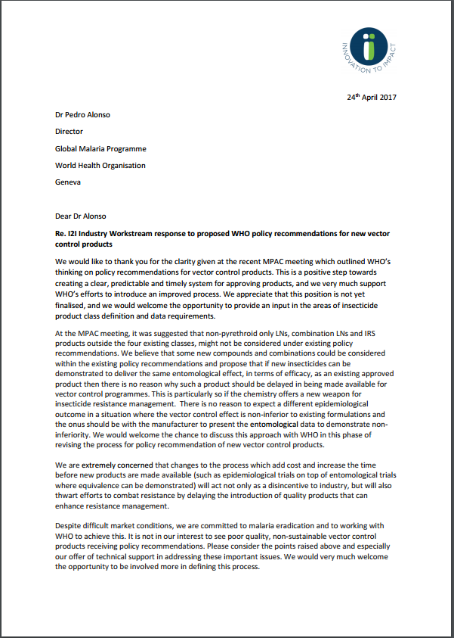
Industry Workstream Outputs
We welcome positive step towards creating a clear, predictable and timely system for approving products
There is no reason to expect a different epidemiological outcome in a situation where the vector control effect is non-inferior to existing formulations
Some non-pyrethroid only LNs, combination LNs and IRS products outside the four existing classes should be considered under existing policy recommendations
Efforts to combat resistance will be thwarted by delaying introduction of quality products that will enhance IRM
If new insecticides can be demonstrated to deliver the same entomological effect as an approved product then evaluation shouldn’t be delayed
Changes to the process which add cost and increase the time to market will act as a disincentive to industry
Workstream letter sent to WHO in April ‘17 prior to VCAG and Study Design Meetings

Slide 13
Industry Workstream View on New WHO System
To be finalised on afternoon of convening Day One in workstream breakouts, but suggested topics are:
Which elements are welcomed?
What questions still remain from the workstream’s perspective?
Constructive Response of the workstream to the new WHO process
What can your workstream do to help harmonise regulatory requirements?
Practical next steps required

Slide 14
Industry Workstream: Future Priorities (agreed in Jan ‘17)
Shift in focus away from WHO
Transformation…
… towards interfaces with other workstreams.
Innovation Efficiency Quality
PQ and policy process: discussion of real-time feedback
Quality Control: Feedback on QA/QC issues and suggested solutions
Integrated Resistance Management: Input into IRM policy and AI testing
GLP: industry experience of working with sites/CROs, site capacity, etc
Country Registration: identify pain points and priorities to address
Harmonised procurement processes: discussion of data requirements

Slide 15

Industry Workstream: Future Priorities
Questions to consider in workstream breakout group (afternoon of convening Day 1):
  Do you envisage additional areas of focus?
  Have some issues become obsolete?
  Do you have the right membership to reach these goals?
  Are there areas where input from other stakeholders is required?
  Do you see the need to a new/more focused group to address a particular issue?

